Slide 1
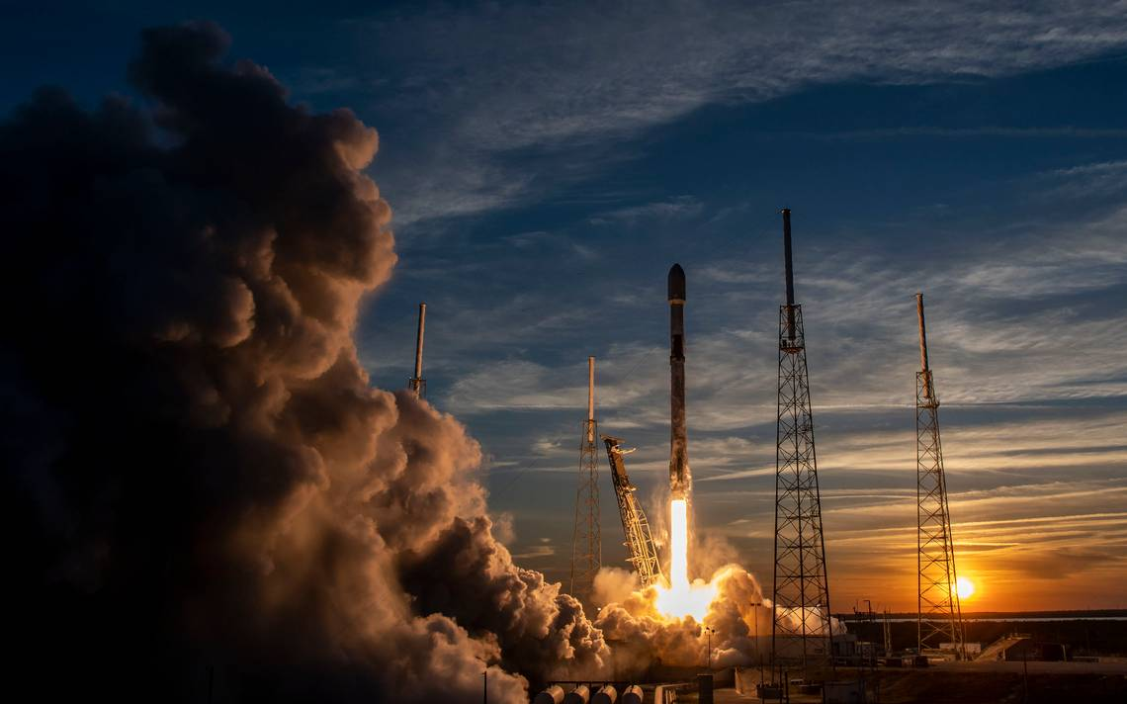

Data Science and Machine Learning Capstone Project
Alberto López García | August, 2024

Slide 2
Outline
Strategic Overview
Background
Framework
Data Presentation
Analysis
Wrap-Up

Slide 3
Strategic Overview
In this comprehensive project, we aim to forecast the successful landing of SpaceX's Falcon 9 first stage using various classification techniques in machine learning. The project is structured around several key phases:
Gathering, cleaning, and organizing data
Conducting initial data investigations
Developing interactive visual representations
Implementing predictive models through machine learning
Our visualizations reveal specific launch characteristics that are linked to either successful or unsuccessful outcomes. Furthermore, our findings suggest that the decision tree algorithm stands out as particularly effective for predicting the landing outcomes of the Falcon 9's first stage.

Slide 4
Background
In our capstone project, the focus is to assess the probability of successful recoveries of SpaceX's Falcon 9 rocket's first stage. Notably, SpaceX offers these launches at a significantly reduced cost of 62 million dollars, in contrast to competitors who may charge over 165 million dollars. This cost efficiency largely depends on the reusability of the rocket's first stage. Determining the likelihood of its successful landing is thus crucial for evaluating the financial feasibility of launches, especially when potential competitors consider placing bids against SpaceX.
It should also be recognized that some landings that do not succeed are pre-planned, such as controlled descents into the ocean. Our main investigative question explores whether we can predict the success of the first stage landing based on various factors, including the mass of the payload, the type of orbit, and the launch location.

Slide 5
Approach
The methodology for this project is comprehensive and multi-faceted, encompassing several stages:
1. Data Acquisition and Preparation: This initial phase involves:
Utilizing the SpaceX API for primary data retrieval.
Implementing web scraping techniques to gather additional data.
Performing data wrangling and formatting to ensure usability.
2. Exploratory Data Analysis (EDA): Key tools and technologies used include:
Pandas and NumPy for data manipulation and analysis.
SQL for querying and managing datasets.

Slide 6
Approach
Data Visualization: We employ various tools to create insightful visual representations:
Matplotlib and Seaborn for static graphing.
Folium for geospatial mapping.
Dash for building interactive web-based visualizations.
Predictive Modeling: We apply several machine learning algorithms to predict outcomes:
Logistic Regression to estimate probabilities.
Support Vector Machine (SVM) for classification tasks.
Decision Tree to model decisions and their possible consequences.
K-Nearest Neighbors (KNN) to classify based on feature similarity.

Slide 7
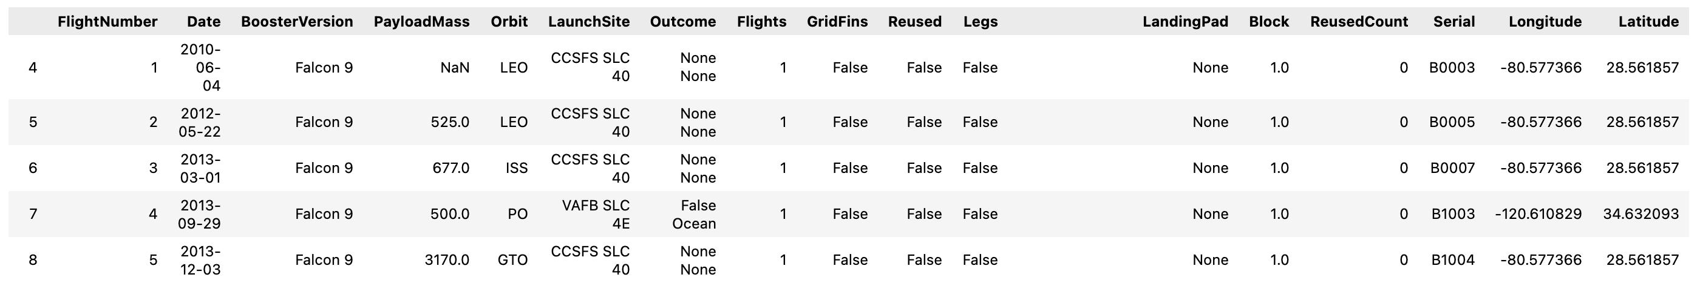
Framework
1. Data Acquisition and Preparation
For this project, we utilized the SpaceX API, accessible at https://api.spacexdata.com/v4/rockets/, to gather comprehensive data on various SpaceX rocket launches. To hone our focus on the Falcon 9 model, we applied filters to the dataset to isolate this specific type of launch. In addressing the issue of missing data within our dataset, each missing value was imputed using the mean of its respective column, ensuring a complete and usable dataset for analysis. After these adjustments, our final dataset comprised 90 instances (rows) and 17 different attributes (columns) relevant to our study. The dataset's structure is illustrated below, where you can see the first few rows showcasing the organized data:

Slide 8

Framework
1. Data Acquisition and Preparation
For supplementing our dataset, we performed web scraping on the dedicated Wikipedia page listing Falcon 9 and Falcon Heavy launches, available at this https://en.wikipedia.org/w/index.php?title=List_of_Falcon_9_and_Falcon_Heavy_launches&oldid=1027686922. We focused our scraping efforts specifically to extract information relevant to Falcon 9 launches only. After processing the scraped data, we structured it into a dataset containing 121 instances (rows) and 11 distinct attributes (columns). Below is an illustration of how the dataset appears with the initial few rows, providing a snapshot of the collected data:

Slide 9
Framework
1. Data Acquisition and Preparation
As part of the data processing phase, we ensured that the dataset was thoroughly cleaned to eliminate any missing entries. This involved techniques such as filling missing values appropriately and ensuring data completeness. To make the dataset suitable for machine learning algorithms, categorical features were transformed using one-hot encoding. This method converts categorical variables into a form that could be provided to ML algorithms to do a better job in prediction. Furthermore, we introduced an additional column labeled ‘Class’ to the dataset. This column plays a crucial role in our analysis by categorizing each launch as either a failure (0) or a success (1), based on the outcome of the launch. This binary classification helps in simplifying the prediction model. After these enhancements, the processed dataset comprised 90 instances (rows) and expanded to 83 columns (features), due to the one-hot encoding of categorical variables. This expanded feature set provides a comprehensive base for our predictive modeling.

Slide 10
Framework
2. Exploratory Data Analysis (EDA):
In this project, we utilized the powerful functionalities of the Pandas and NumPy libraries to analyze and summarize the data collected. Specific tasks accomplished using these libraries included:
Calculating the number of launches at each site: This involved grouping the data by the launch site and counting the number of instances for each group.
Determining the frequency of each orbit type: By grouping the data by orbit type, we were able to calculate how frequently each orbit was used.
Assessing the distribution of mission outcomes: This required counting the occurrences of each type of mission outcome (e.g., success, failure).

Slide 11
Framework
2. Exploratory Data Analysis (EDA):
In addition to using Pandas and NumPy for preliminary data exploration, SQL was employed to perform more targeted queries on the dataset, allowing for deeper insights into specific aspects of the launch data. Queries executed included:
Identifying unique launch sites: This query helped to ascertain the various launch sites utilized in the space missions.
Calculating the total payload mass for NASA (CRS) launches: We aggregated the payload masses of launches specifically for NASA under the Commercial Resupply Services contract.
Determining the average payload mass for Falcon 9 version 1.1 boosters: This involved calculating the mean payload mass carried by this specific version of the Falcon 9 booster, highlighting the capabilities of different booster versions.

Slide 12
Framework
3. Data Visualization
To enhance our understanding of the SpaceX Falcon 9 launch data, we employed visualization techniques using the Matplotlib and Seaborn libraries, which are powerful tools for creating static and interactive visualizations in Python.
Matplotlib and Seaborn Visualizations:
Scatter plots: These were utilized to examine relationships between continuous variables such as the payload mass and the flight number for each launch site, providing insights into operational patterns.
Bar charts: Effective for categorical data, bar charts helped in visualizing the frequency of launches from different sites and the success rates associated with different orbit types.
Line charts: Used to track changes over time, such as the evolution of launch success rates or payload capacities over successive flights.

Slide 13
Framework
3. Data Visualization
Folium for Interactive Mapping:
Folium, a Python library that facilitates the creation of interactive maps using Leaflet.js, was instrumental in geospatial analysis of the launch sites. Key implementations included:
Marking launch sites: Each launch site was pinpointed on the map, providing a geographical overview of SpaceX operations.
Distinguishing mission outcomes: We differentiated between successful and failed launches at each site using distinct markers, allowing for an immediate visual distinction of performance across different locations.
Proximity markers: Additional markers were used to show important proximities such as the nearest city, railway stations, or highways to each launch site. This helps in assessing logistical advantages or challenges faced by each launch site.

Slide 14
Framework
3. Data Visualization
For this project, we leveraged Dash, a Python web framework built on top of Plotly.js, to develop an interactive web application that allows users to explore and interact with the SpaceX Falcon 9 launch data more dynamically. Dash enables the creation of HTML components using Python, and it's especially useful for building data visualization interfaces.
Key Features of the Dash Application:
Interactive Components: We incorporated a dropdown menu and a range slider within the dashboard. The dropdown menu allows users to select specific launch sites for detailed examination, while the range slider enables filtering of the data based on criteria such as date range, payload mass, or flight number.

Slide 15
Framework
3. Data Visualization
Data Visualization Tools:
Pie Chart: This chart provides a visual breakdown of the total successful launches from each selected launch site, enabling users to quickly gauge the success rate relative to other sites.
Scatter Plot: Designed to analyze the relationship between payload mass and mission outcomes, this plot helps identify trends or patterns, such as whether heavier payloads have higher success rates or specific challenges.
Interactive Data Analysis:
The interactive site, powered by Dash, not only visualizes data but also allows users to manipulate the view according to their specific interests or areas of focus. For instance, users can choose to view data from a particular year, or focus on launches with specific payload criteria, adjusting the visual outputs in real time.

Slide 16
Framework
4. Learning Prediction
The machine learning prediction phase of our project leverages the Scikit-learn library, a robust toolset for implementing various machine learning algorithms. The following steps outline our methodology for developing predictive models to determine the success of SpaceX Falcon 9 first stage landings:
1. Standardizing the Data: To ensure that our model handles all features equally, we normalize the dataset. This step helps remove any bias that might be caused by the scales of the variables, making the training process more efficient and effective.
2. Splitting the Data: The dataset is divided into two parts: a training set and a test set. Typically, the training set comprises a larger portion of the data, which is used to train the models, while the test set is reserved to evaluate their performance.

Slide 17
Framework
4. Learning Prediction
Creating Machine Learning Models: We implement several machine learning algorithms to find the most effective one for our prediction task:
Logistic Regression: A statistical model that predicts the probability of a binary outcome.
Support Vector Machine (SVM): A powerful classification technique that works well in high-dimensional spaces.
Decision Tree: A model that uses a tree-like graph of decisions and their possible consequences.
K-Nearest Neighbors (KNN): A method that classifies each data point based on how its neighbors are classified.

Slide 18
Framework
4. Learning Prediction
Fitting the Models on the Training Set: Each model is trained using the training dataset to learn from the features.
Hyperparameter Tuning: This involves experimenting with various settings for the models to determine the best combination of parameters that improves their performance.
Model Evaluation:
Accuracy Scores: Each model’s accuracy is assessed by comparing the predicted results with the actual outcomes in the test set.
Confusion Matrix: This tool helps visualize the performance of an algorithm. It shows the correct and incorrect predictions made by the model across different classes, providing insight into how well the model is predicting each class.

Slide 19
Data Presentation
The results of our analysis of SpaceX Falcon 9 launch data are organized into five key sections, each employing specific tools and techniques for insight extraction:
SQL (EDA with SQL): This section demonstrates the exploratory data analysis performed using SQL queries. It includes the extraction of specific information such as unique launch sites, payload masses for different missions, and average payload masses for various booster versions. This helps in understanding the distribution and characteristics of the data at a granular level.
Matplotlib and Seaborn (EDA with Visualization): Here, we utilize Matplotlib and Seaborn to create a series of visualizations that illustrate the relationships within the data. Scatter plots, bar charts, and line charts display relationships and trends such as the correlation between flight numbers and launch sites, payload mass versus launch outcomes, and success rates across different orbit types.

Slide 20
Data Presentation
Folium: This part of the report uses Folium to provide interactive geographical visualizations. Maps highlight the locations of launch sites and distinguish between successful and unsuccessful launches at each site. Additional markers indicate proximity to key infrastructure like cities, railways, and highways, offering insights into logistical advantages or challenges for each site.
Dash: Dash is used to create an interactive web application that allows users to manipulate the data visualization through user interfaces such as dropdown menus and range sliders. The visual outputs here include pie charts showing the distribution of successful launches by site and scatter plots that explore the relationship between payload mass and launch success.

Slide 21
Data Presentation
5. Predictive Analysis: The final section focuses on the application of machine learning algorithms to predict launch outcomes. We detail the process of standardizing data, splitting it into training and testing sets, fitting models like Logistic Regression, SVM, Decision Trees, and KNN, and tuning their hyperparameters. Model performance is evaluated using accuracy scores and confusion matrices, with each model's effectiveness at predicting launch outcomes (class 0 for failure, class 1 for success) thoroughly analyzed.

Slide 22
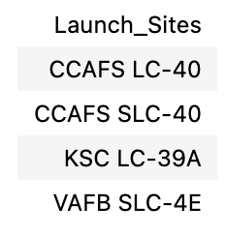
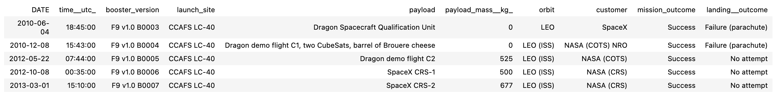
Data Presentation
1. SQL (EDA with SQL)
Catalog of all unique launch sites involved in the space missions
Five specific entries for launch sites that commence with 'CCA'

Slide 23
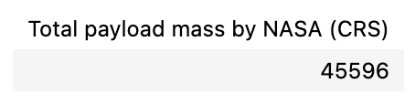
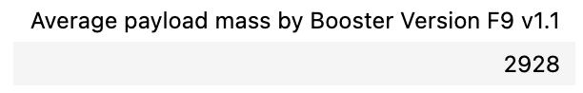
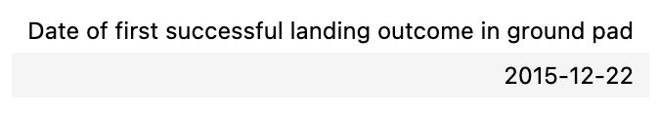
Data Presentation
1. SQL (EDA with SQL)
The cumulative payload mass transported by NASA's CRS mission boosters.
The mean payload mass transported by the Falcon 9 version 1.1 boosters.
The date of the inaugural successful ground pad landing.

Slide 24
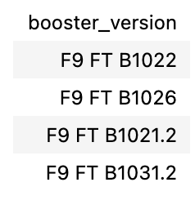
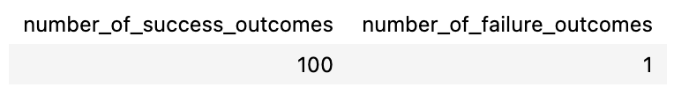
Data Presentation
1. SQL (EDA with SQL)
Names of boosters that achieved success on a drone ship with payloads between 4000 and 6000 kilograms.
The aggregate count of successful and failed mission outcomes.

Slide 25
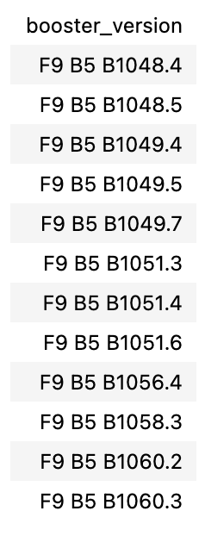
Data Presentation
1. SQL (EDA with SQL)
The booster versions that have transported the heaviest payloads.

Slide 26
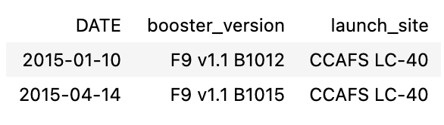
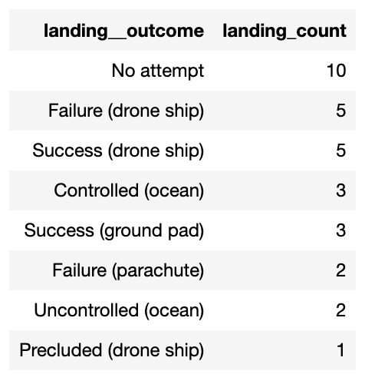
Data Presentation
1. SQL (EDA with SQL)
Failed drone ship landing outcomes in 2015, including booster versions and launch site names.
The count of landing outcomes between 2010-06-04 and 2017-03-20, listed in descending order.

Slide 27
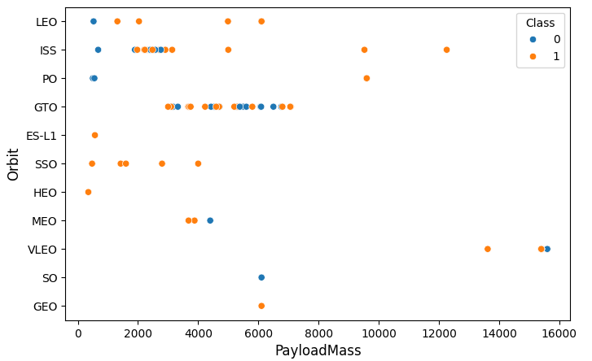
Data Presentation
2. Matplotlib and Seaborn
The correlation between payload mass and orbit type.

Slide 28
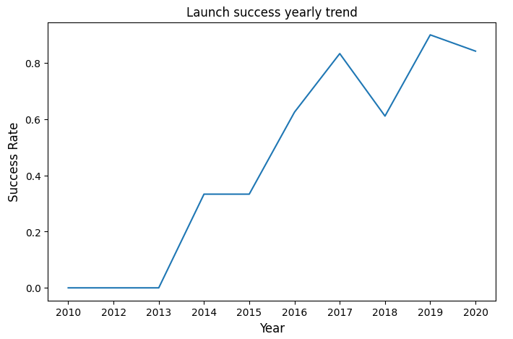
Data Presentation
2. Matplotlib and Seaborn
The annual trend in launch success rates.

Slide 29

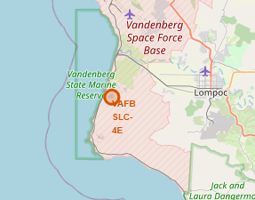
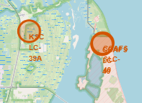
Data Presentation
3. Folium
All launch sites displayed on a map.

Slide 30
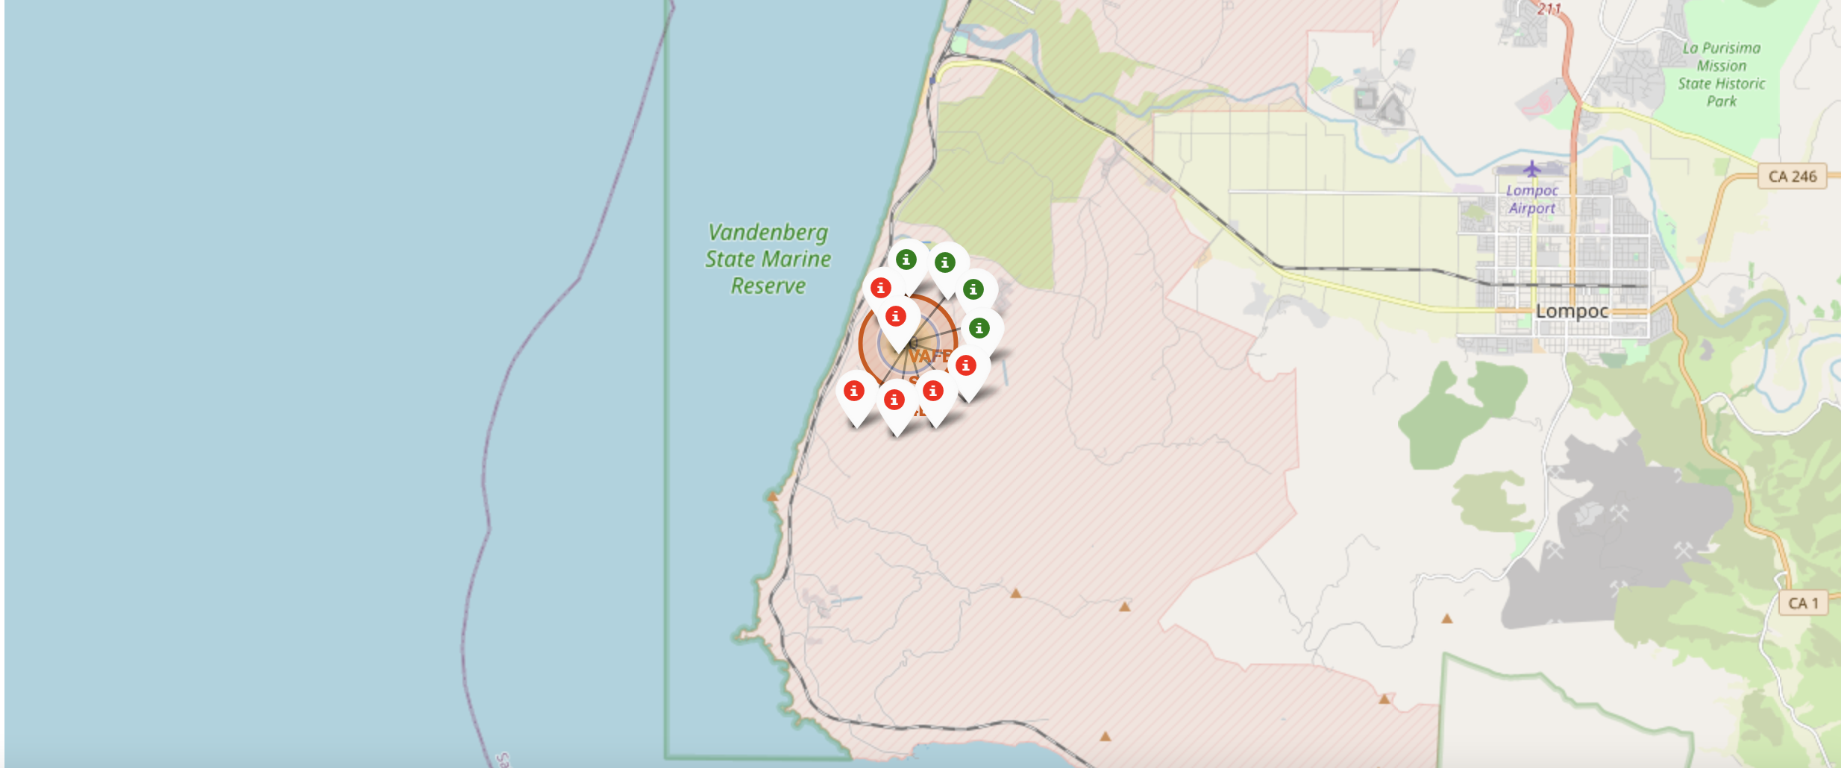
Data Presentation
3. Folium
The successful and failed launches for each site displayed on a map. Zooming in on a launch site reveals green and red tags, where green tags indicate successful launches and red tags indicate failed launches.

Slide 31
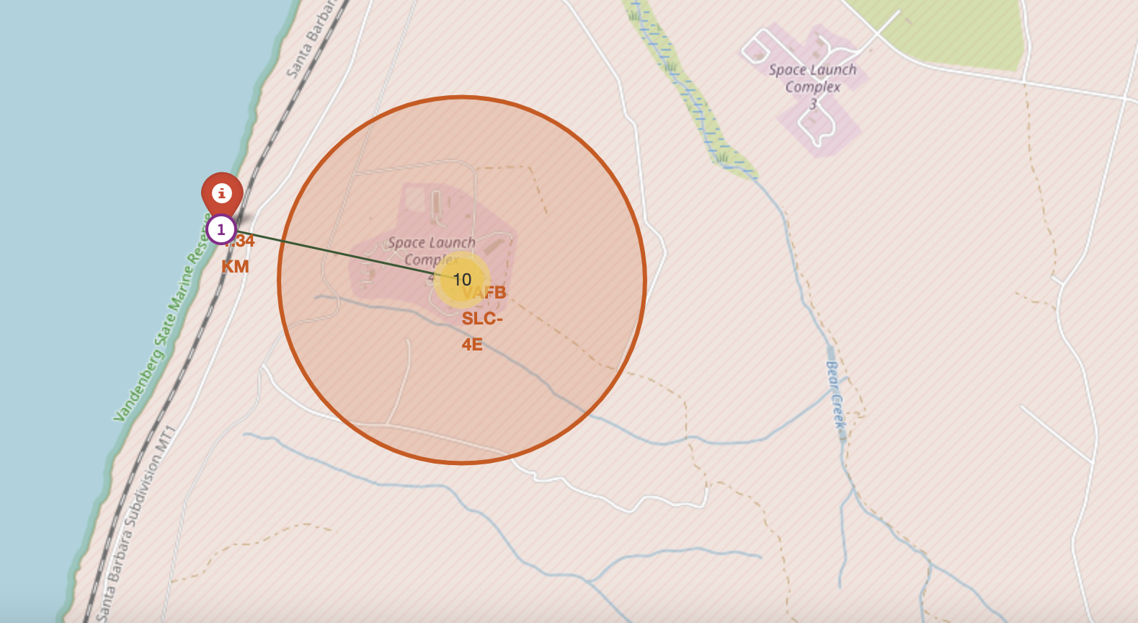
Data Presentation
3. Folium
The distances from a launch site to nearby landmarks such as the closest city, railway, or highway. The image below illustrates the distance from the VAFB SLC-4E launch site to the nearest coastline.

Slide 32

Data Presentation
4. Dash
The image below displays a pie chart for the launch site CCAFS LC-40. In this chart, 0 indicates failed launches and 1 indicates successful launches. It reveals that 73.1% of the launches at CCAFS LC-40 have been unsuccessful.

Slide 33
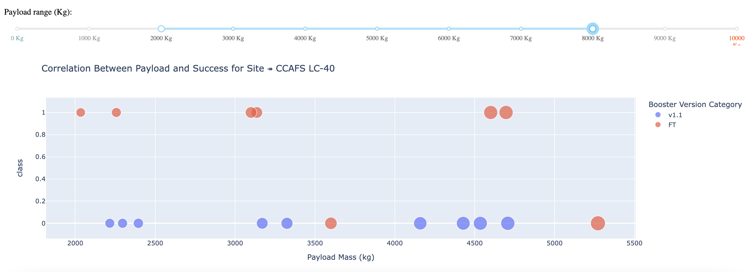
Data Presentation
4. Dash
The image below displays a scatterplot for payload masses ranging from 2000kg to 8000kg. In this scatterplot, Class 0 represents failed launches, and Class 1 represents successful launches.

Slide 34

Data Presentation
5. Predictive Analysis
Logistic Regression Results:
GridSearchCV Best Score: 0.8464285714285713
Accuracy Score on Test Set: 0.8333333333333334
Confusion Matrix:

Slide 35
Data Presentation
5. Predictive Analysis
Support Vector Machine (SVM) Results:
GridSearchCV Best Score: 0.8482142857142856
Accuracy Score on Test Set: 0.8333333333333334
Confusion Matrix:

Slide 36
Data Presentation
5. Predictive Analysis
Decision Tree Results:
GridSearchCV Best Score: 0.8892857142857142
Accuracy Score on Test Set: 0.8333333333333334
Confusion Matrix:

Slide 37
Data Presentation
5. Predictive Analysis
K-Nearest Neighbors (KNN) Results:
GridSearchCV Best Score: 0.8482142857142858
Accuracy Score on Test Set: 0.8333333333333334
Confusion Matrix:

Slide 38
Analysis
From the data visualization section, it is evident that certain features may correlate with mission outcomes in various ways. For instance, heavier payloads tend to have higher successful landing rates for orbit types such as Polar, LEO, and ISS. However, for GTO orbits, the distinction is less clear, as both successful and unsuccessful landing rates are observed.
Thus, each feature may influence the final mission outcome to some extent. While the specific impact of each feature on the mission outcome can be complex and not immediately apparent, machine learning algorithms can be employed to discern patterns in historical data. These algorithms can then predict the likelihood of a mission's success based on the given features.

Slide 39
Wrap-Up
In this project, we aim to predict whether the first stage of a given Falcon 9 launch will successfully land, which in turn helps determine the cost of the launch. Each feature of a Falcon 9 launch, such as payload mass or orbit type, can influence the mission outcome. We employed several machine learning algorithms to analyze past Falcon 9 launch data and develop predictive models.
Among the four machine learning algorithms tested, the predictive model produced by the decision tree algorithm demonstrated the highest performance.

